Slide 1
Lecture11 Course Wrap Up
Lek Hsiang Hui

Slide 2
Outline
SDLC
SDLC Phases
System Development Disciplines
Exam Format

Slide 3
SDLC

Slide 4
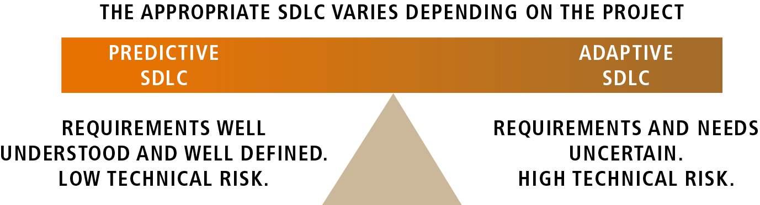
Predictive and Adaptive SDLC

Slide 5
SDLC Phases

Slide 6

Phases
We can generalize SDLC into 5 different phases:
Initiation
Discovery
Construction
Final Verification and Validation
Closeout

Slide 7
Intiation

Slide 8
Intiation Diagrams
Business use case diagram
Activity diagram
Rolemap
Event table
System use case diagram

Slide 9
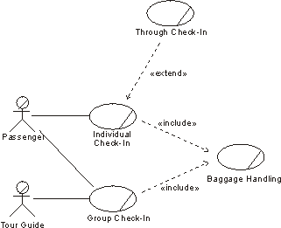
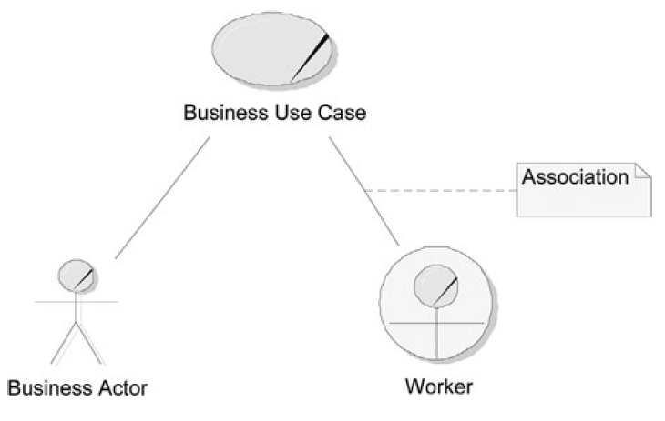
Business Use-Case Diagram
Business actor: someone external to the business
Worker: someone who works within the business
Association: indicates that the actor interacts with the business over the course of the business use case

Slide 10
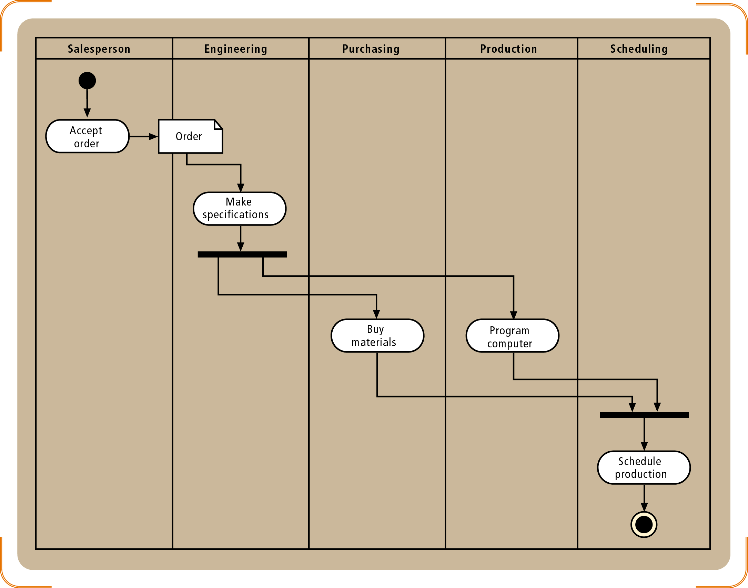
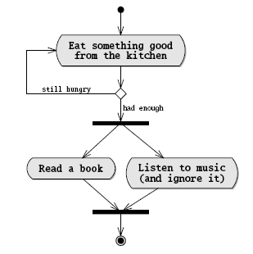
Activity Diagram
Activity diagram (use to model workflow : general business workflow or system use case flow)

Slide 11
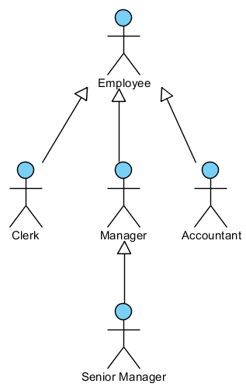
Rolemap
Role map (identify the relationship between the different actors – potential users of the system)

Slide 12
Event Table
EVENT | TRIGGER | SOURCE | USE CASE | RESPONSE | DESTINATION
1. Customer wants to check item availability | Item inquiry | Customer | Look up item availability | Item availability details | Customer
2. Customer places an order | New order | Customer | Create new order | Real-time link Order confirmation Order details Transaction | Credit bureau Customer Shipping Bank
3. Customer changes or cancel order | Order change request | Customer | Update order | Change confirmation Order change details Transaction | Customer Shipping Bank
4. Time to produce order summary reports | “End of week, month, quarter, and year” |  | Produce order summary reports | Order summary reports | Management
5. Time to produce transaction summary reports | “End of day” |  | Produce summary transaction reports | Transaction summary reports | Accounting
6. Customer or management wants to check order status | Order status inquiry | Customer or management | Look up order status | Order status details | Customer or management

Slide 13
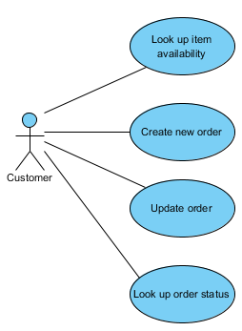
System use case diagram
System use case diagram (system use cases can be obtained from the event table)

Slide 14
Discovery

Slide 15
Discovery Diagrams
Use case description
(More) activity diagram
State-machine diagram / state-chart
System sequence diagram (SSD)
Domain model diagram

Slide 16
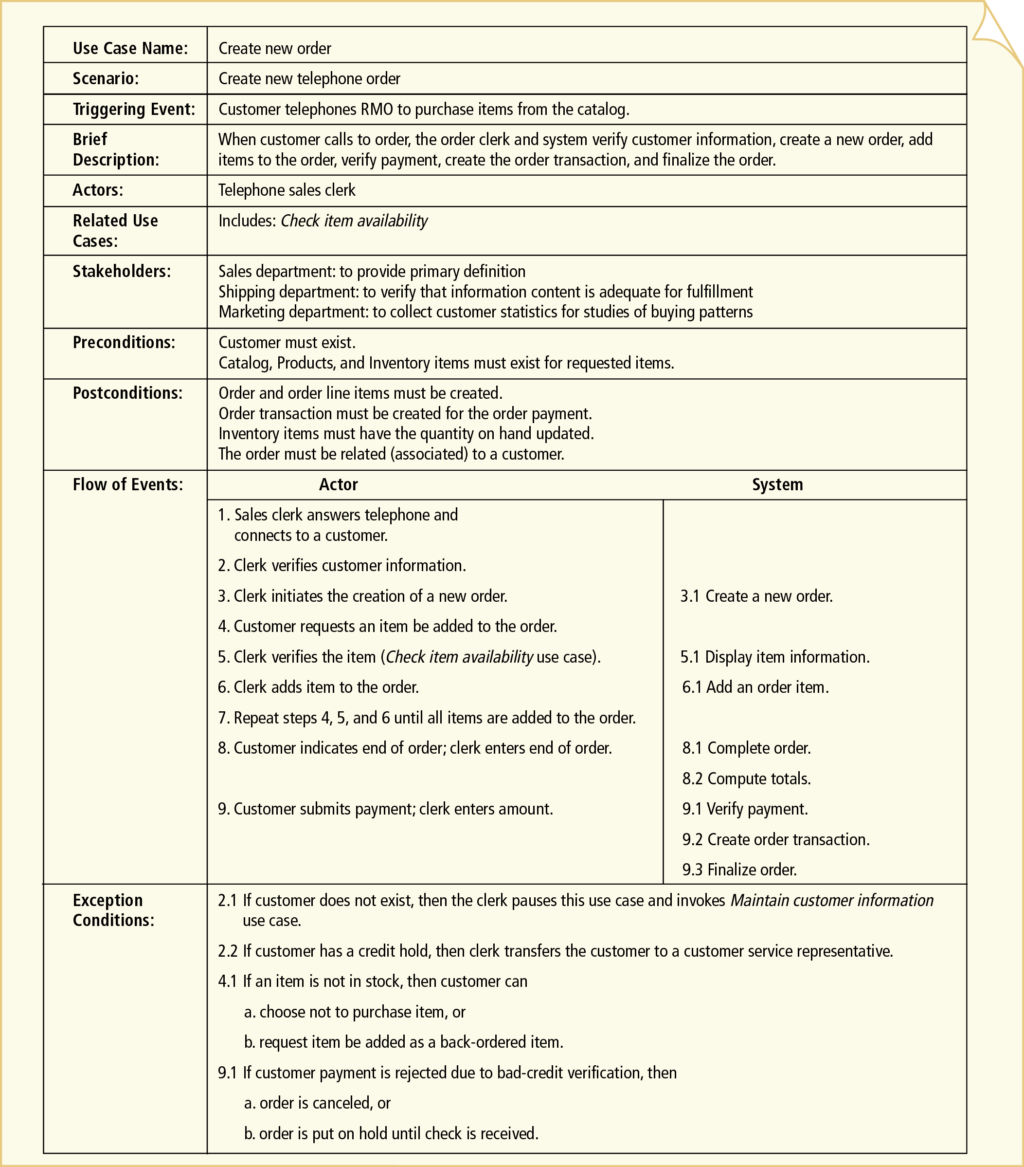
Use Case Description
IS2102 Requirements Analysis and Design
Notes:
16

Slide 17
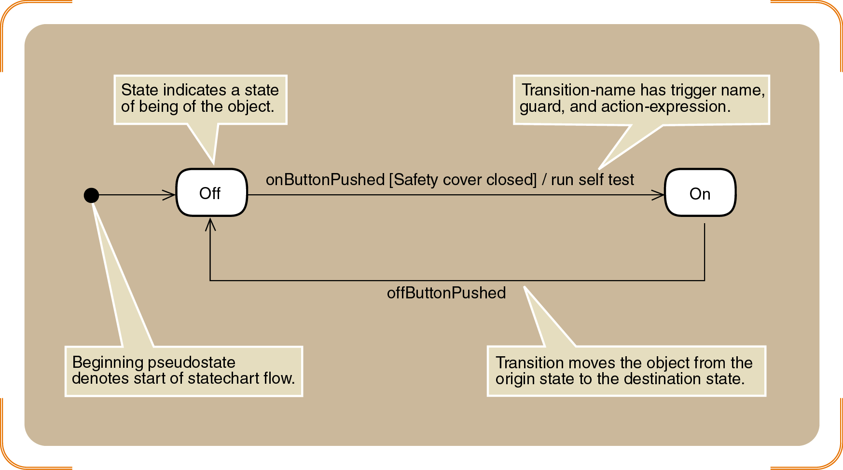
State-chart

Slide 18
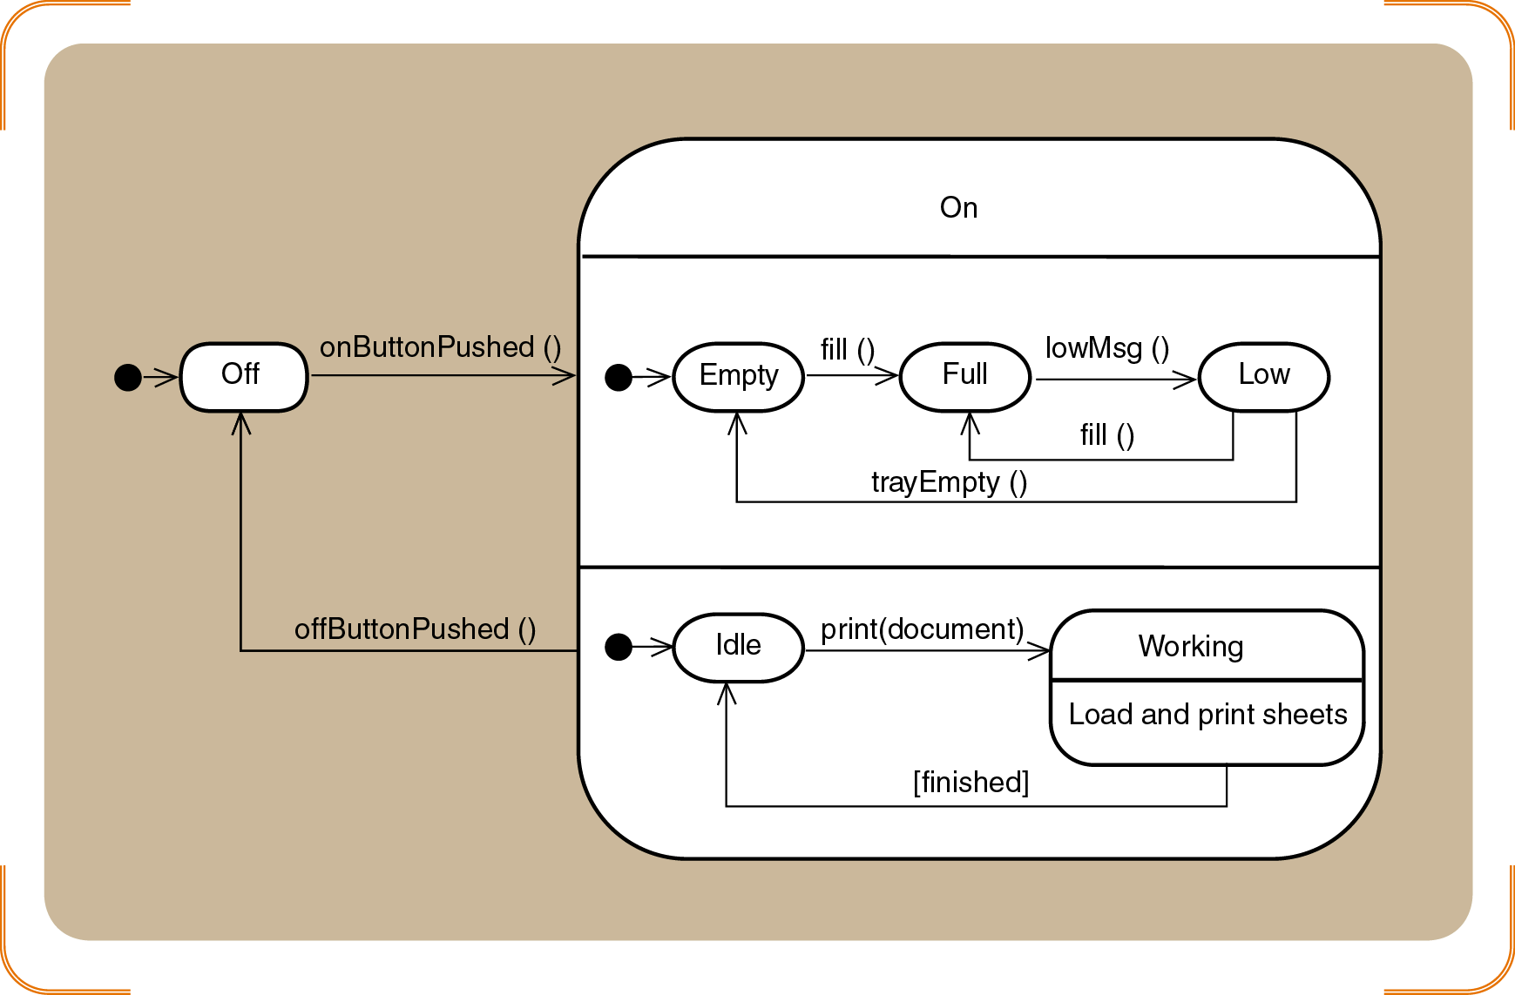
Concurrent and Composite State for the Printer Object

Slide 19
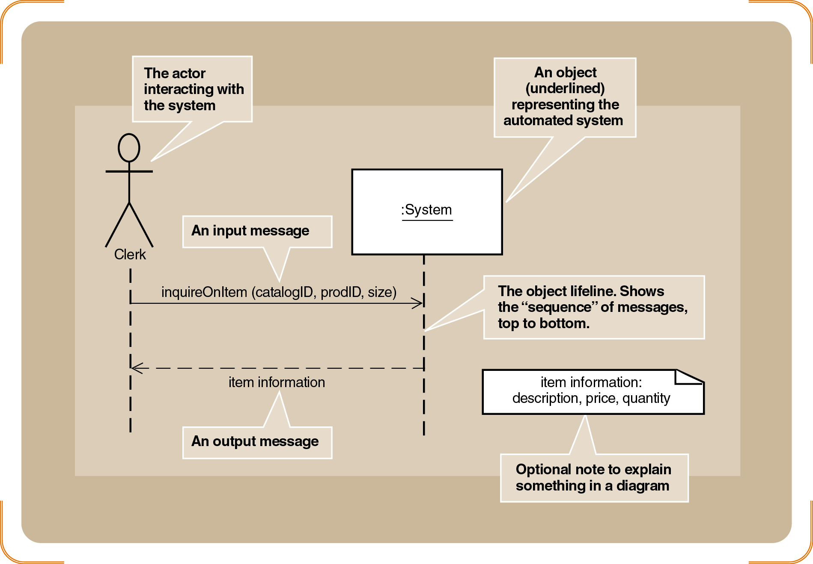
System Sequence Diagram (SSD)

Slide 20
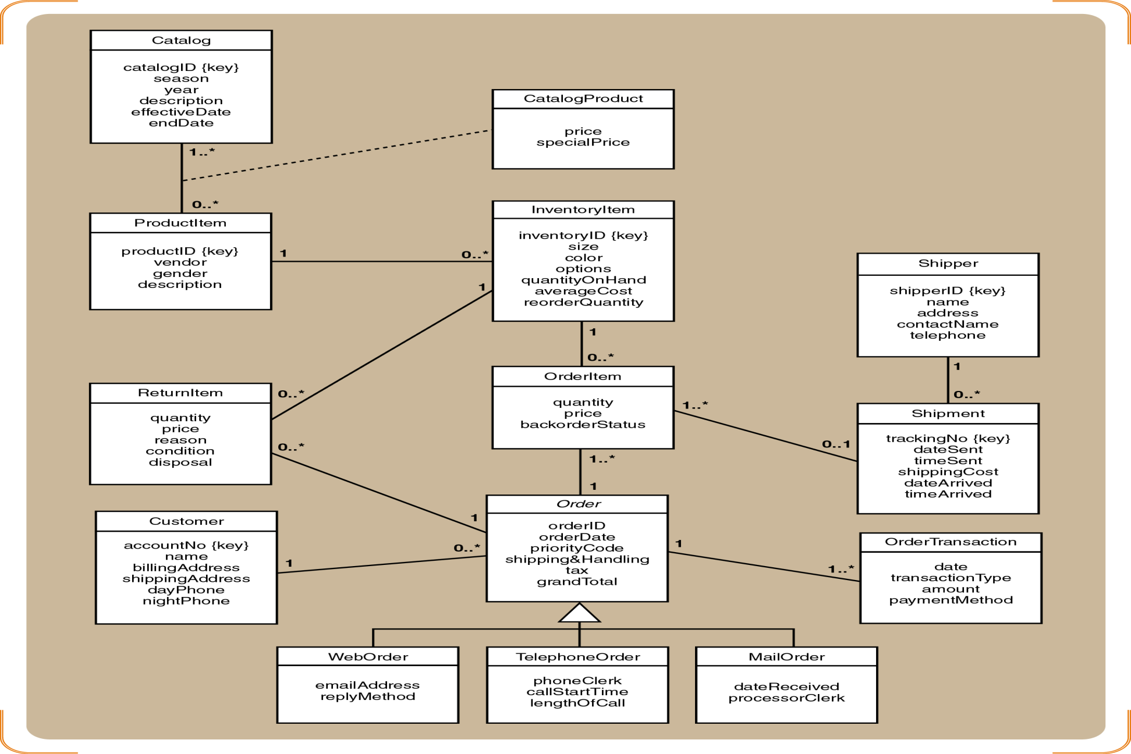
Domain Model Class Diagram
Domain Model Class Diagram only contains the Classes, Attributes Associations. It doesn’t have the operations/methods

Slide 21
Construction

Slide 22
Construction Diagrams
Design class diagram
Communication diagram
Sequence diagram

Slide 23
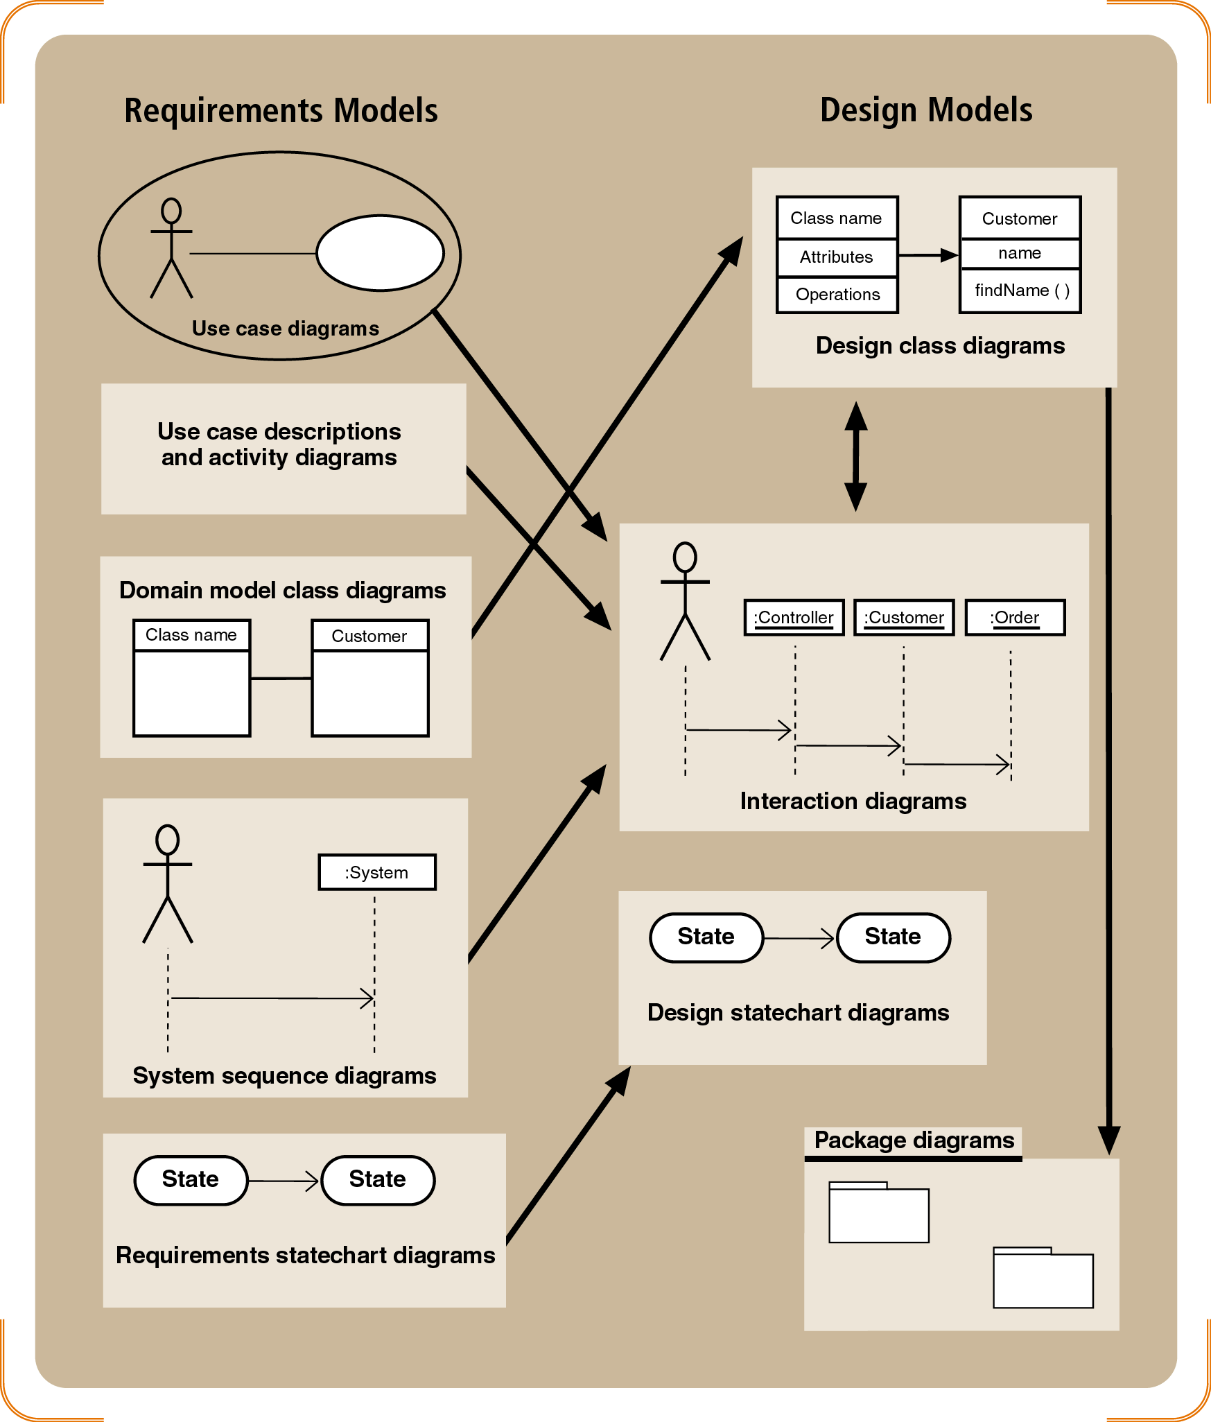
Requirements and Design Models

Slide 24
Starting point: Domain Model Class Diagram

Slide 25
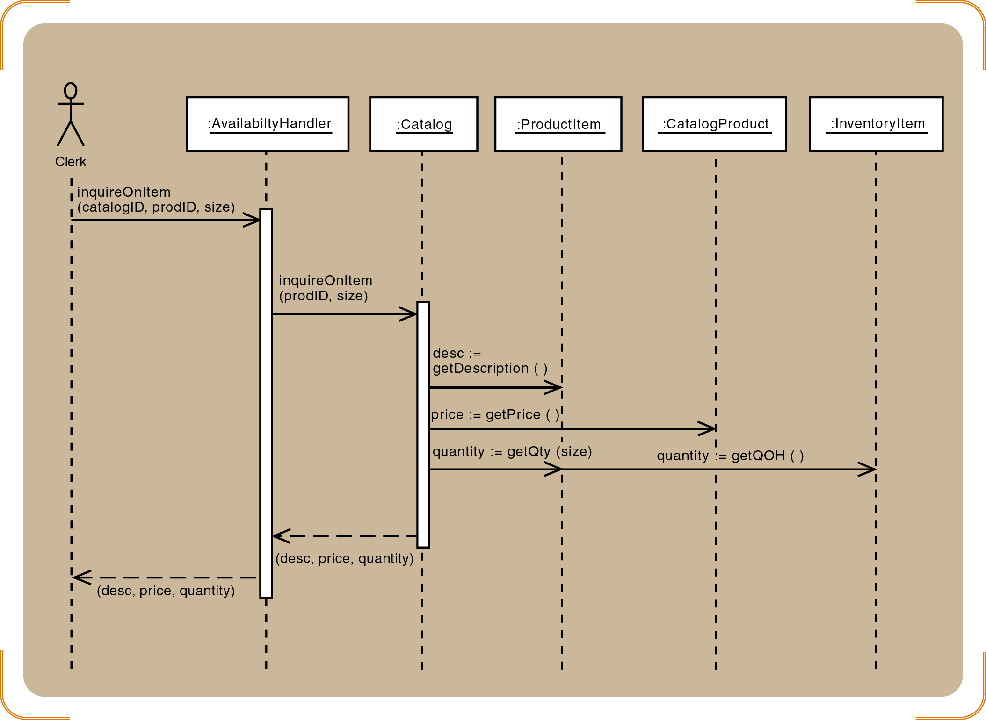
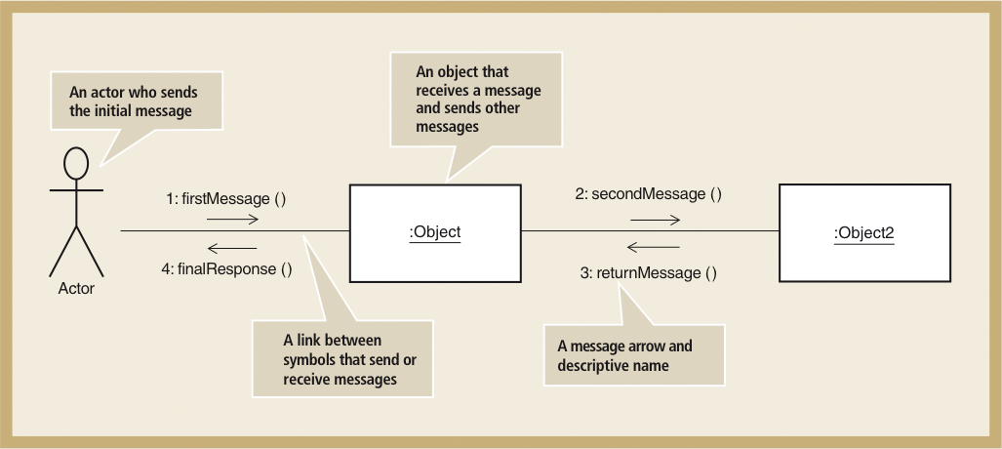
Communication Diagrams and Sequence Diagram
Communication Diagram
Sequence Diagram

Slide 26
Starting Point: System Sequence Diagram

Slide 27
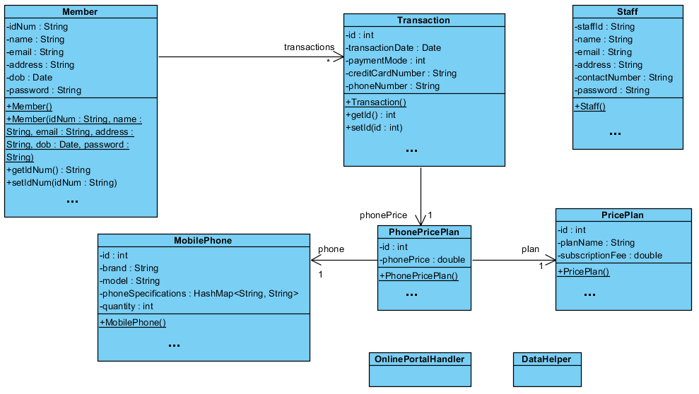
Design Class Diagram

Slide 28
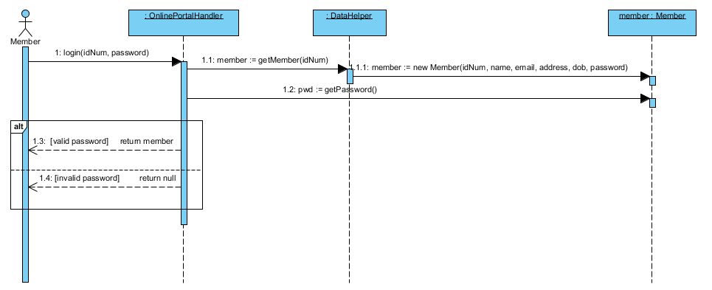
Sequence Diagram

Slide 29
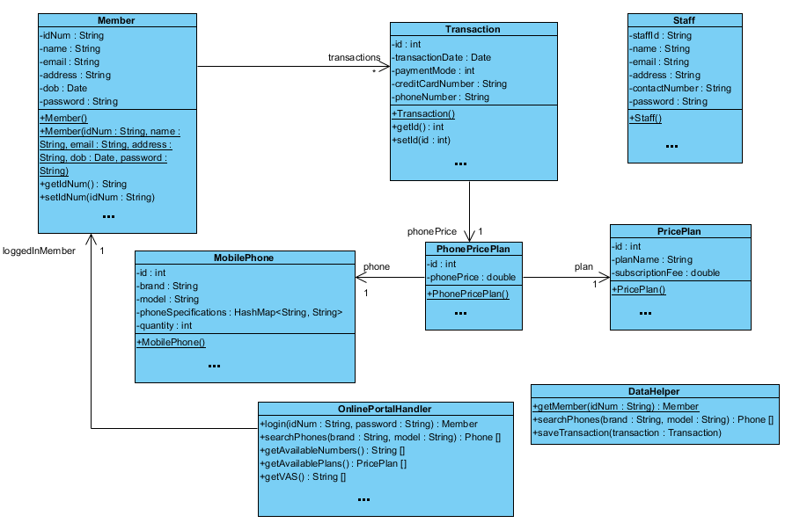
Design Class Diagram
Improve on the class diagram

Slide 30

Software design Patterns
Often we find that many software systems have similar architectural structures, design patterns are approaches to design the architecture

Slide 31
Types of design patterns
Structural
MVC
Façade
Adaptor
Creational
Singleton
Factory
Object Pool
Behavioral
Strategy
Observer

Slide 32
Final Verification and Validation Phase

Slide 33
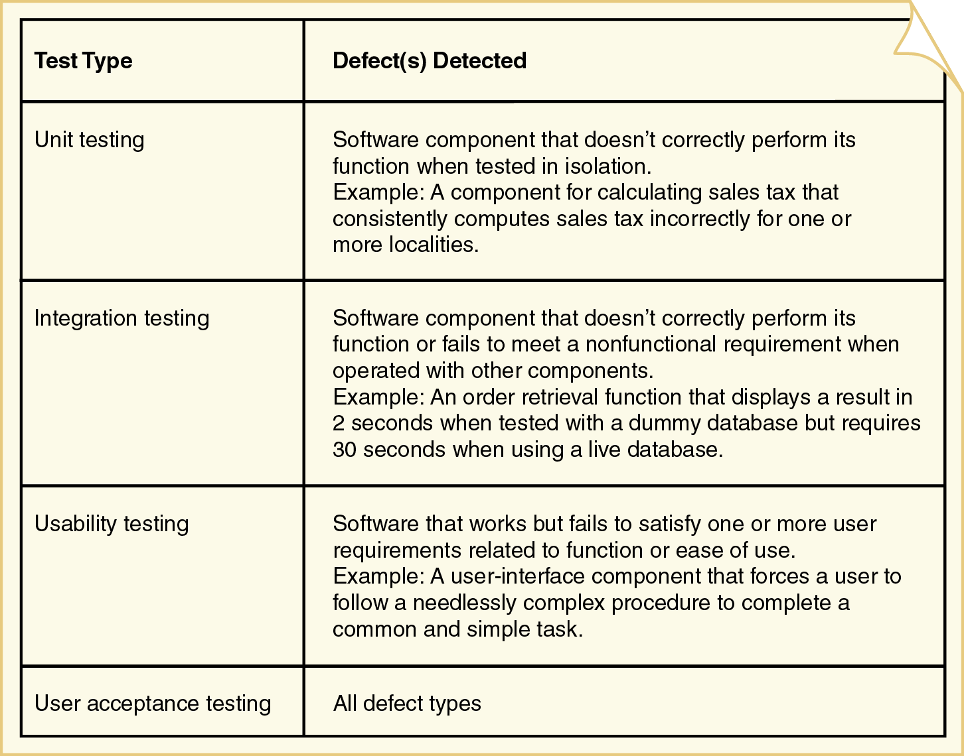
Test types and detected defects

Slide 34
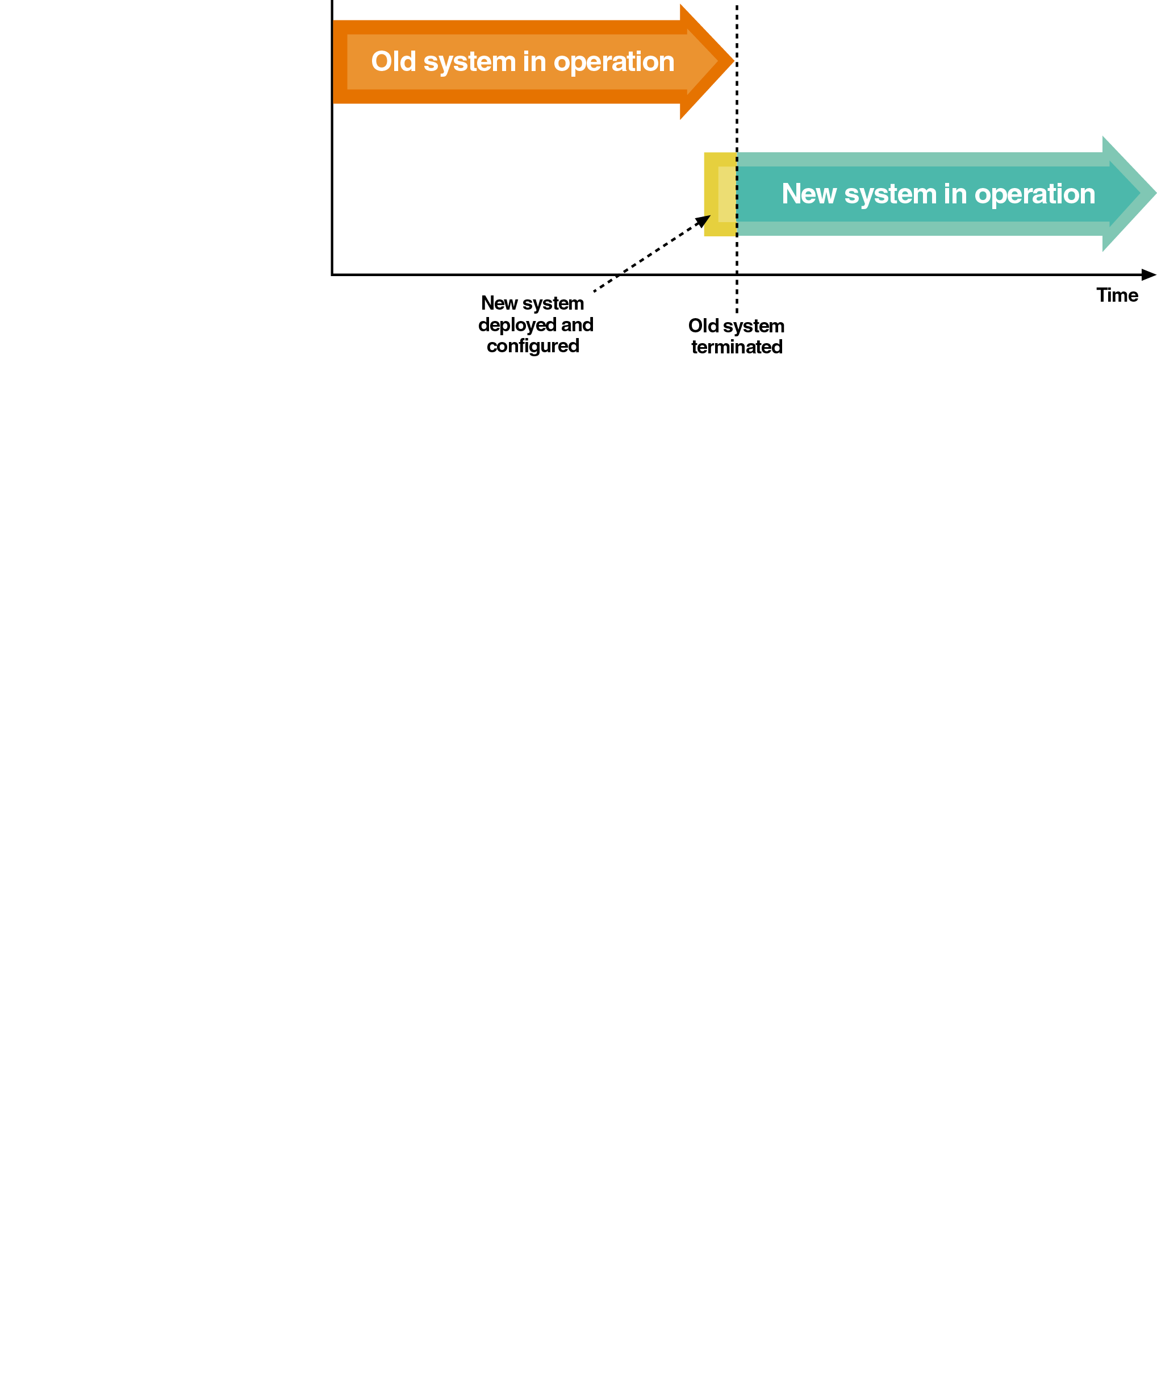
Direct Deployment
Installs a new system, quickly makes it operational, and immediately turns off any overlapping systems
Advantages
Simplicity
Disadvantages
Risk of system unavailability
Used when a new system is not replacing an old system and/or downtime can be tolerated

Slide 35
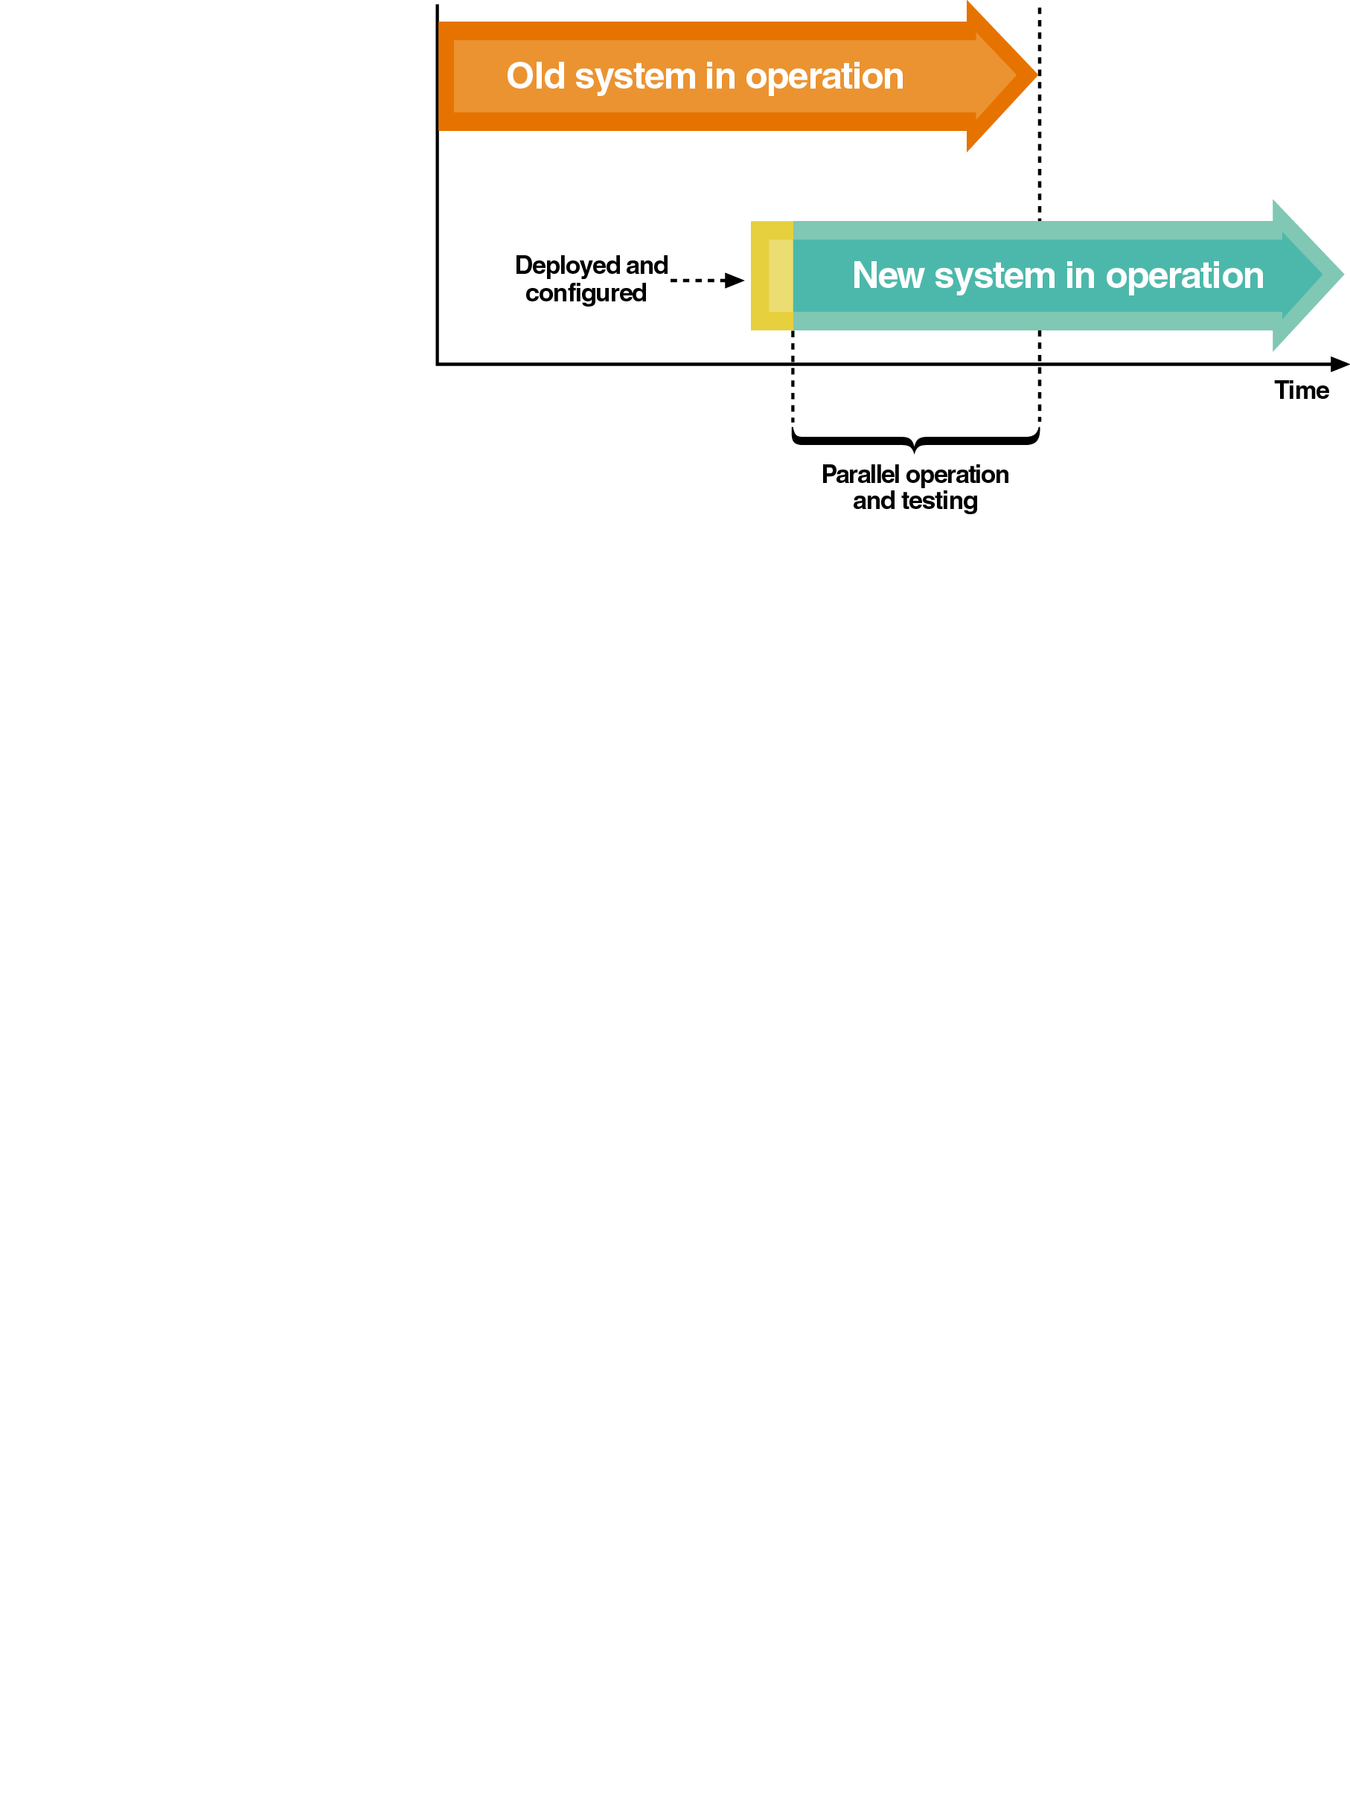
Parallel Deployment
Operates both old and new systems for an extended time period
Advantages
Relatively low risk of system failure
Disadvantage
Cost to operate both systems
Used for mission-critical applications
Partial parallel deployment can be implemented with increased risk of undetected errors

Slide 36
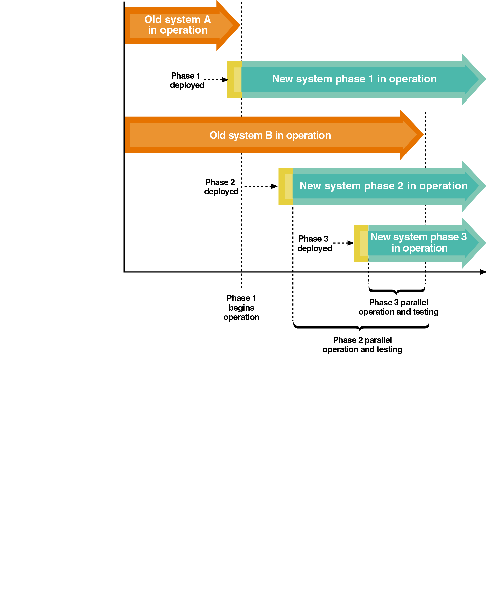
Phased Deployment
Installs a new system and makes it operational in a series of steps or phases
Advantages
Reduced risk
Disadvantages
Increased complexity
Useful when a system is large, complex, and composed of relatively independent subsystems

Slide 37
Exam Format

Slide 38
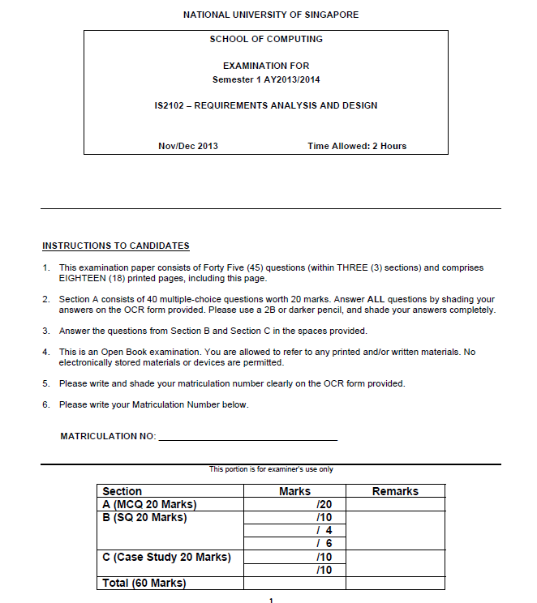
3 sections

Slide 39
Section A
40 MCQs (0.5% each)

Slide 40
Section B (structured)
3 questions (10 + 4 + 6 = 20%)

Slide 41
Section C (Case Study)
2 questions (10 + 10 = 20%)

